Slide 1
Characterizing Power Management Opportunities for LLMs in the Cloud
MT25090
Introduction & Motivation
Background
Rapid growth of Large Language Models (LLMs)
Massive increase in GPU demand in data centers
Examples:
  GPT scale models → thousands of GPUs
Inference workloads dominate (~90% of compute)
Problem Statement
Datacenter constraints:
  Power
  Cooling
  Space
Power is the main bottleneck
Adding servers without control leads to exceed in power budget
Need for efficient power management techniques

Slide 2
LLMs in Cloud
LLM Architecture Overview
Transformer-based models:
  Encoder (BERT)
  Decoder (GPT)
  Encoder-Decoder (T5)
Key components:
  Attention layers
  MLP layers
Used for:
  Text generation
  NLP tasks
Training vs Inference
Training
  Heavy compute + communication
  Large clusters (1000s of GPUs)
Inference
  Only forward pass
  Lower compute per request
Inference dominates real-world usage

Slide 3
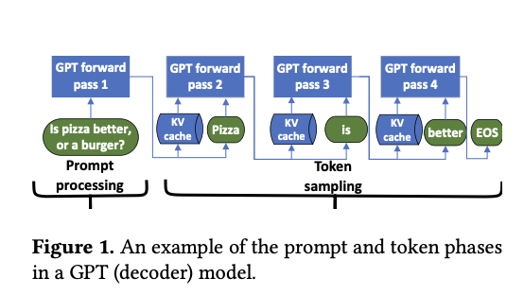
Phases in decoder model

Slide 4
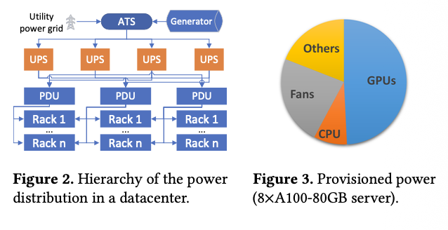
Power setup and consumption in DCs

Slide 5
Power Infrastructure & Challenges
Datacenter Power Hierarchy
Utility → UPS → PDU → Racks → Servers
GPUs consume major share of power
Provisioning based on peak usage
Challenges
No unified GPU power control
Limited workload visibility (VMs)
Slow Out-of-Band (OOB) controls (up to 40s)
Hard to implement real-time power management

Slide 6
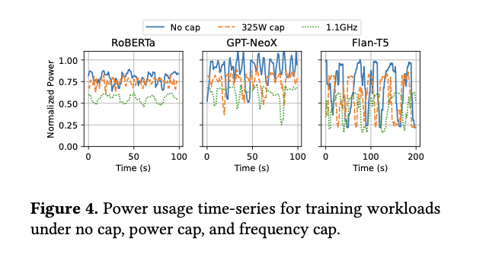
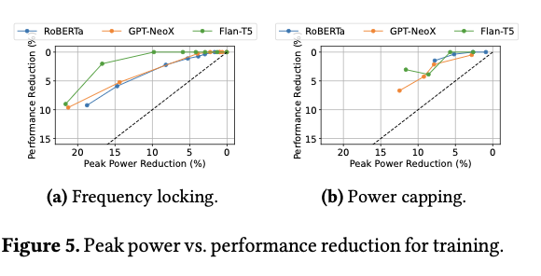
Power Characterization
Training Power Patterns
Observations:
  Power reaches GPU TDP or exceeds
  Large power swings per iteration
Cause:
  Alternating compute & communication phases
Insight:
  Training needs overprovisioned power

Slide 7
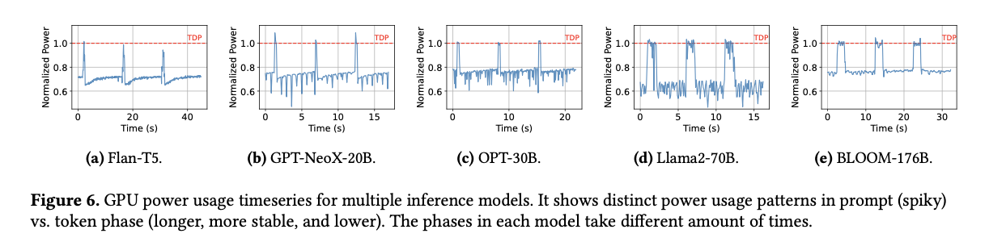
Inference Power Patterns
Two phases:
  Prompt phase → high power spike
  Token phase → lower, stable power
Key insight:
  Peak doesn’t mean average power
Implication:
  Huge unused power headroom in inference

Slide 8
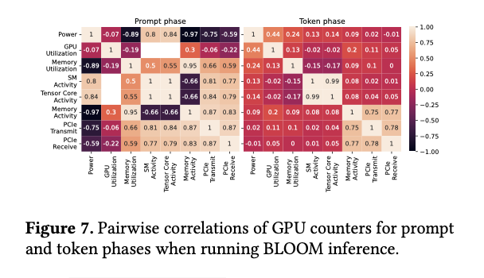

Slide 9
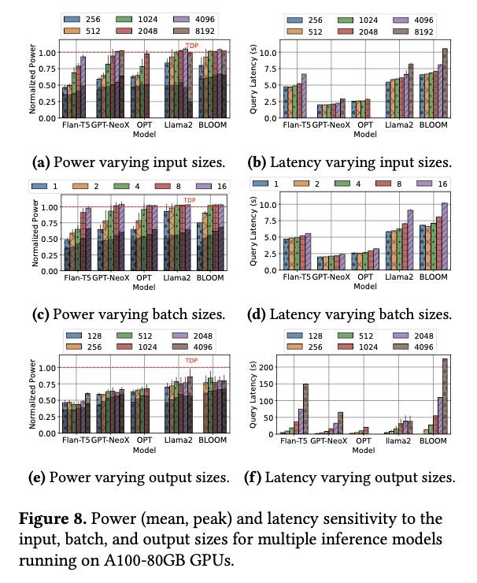
Multiple models at inference phase

Slide 10
Power Optimisation Techniques
Frequency Locking
Fix GPU clock frequency
Reduces overall power
Pros:
  Predictable control
  Efficient power saving
Cons:
  Slight performance drop

Slide 11
Power Capping
Limits power using thresholds
Reactive mechanism
Pros:
  Controls peak power
Cons:
  Less reliable than frequency locking
Insight:
  Best for reducing spikes

Slide 12
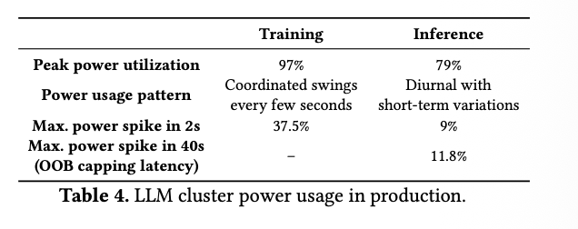
Key Insights from Study
Training Insights
High peak power (≈ TDP)
Large synchronized power swings
Very low headroom (~3%)
Hard to oversubscribe power
Inference Insights
Lower average power than peak
Uncorrelated workloads → smoother cluster usage
High headroom (~21%)
Ideal for power optimization

Slide 13
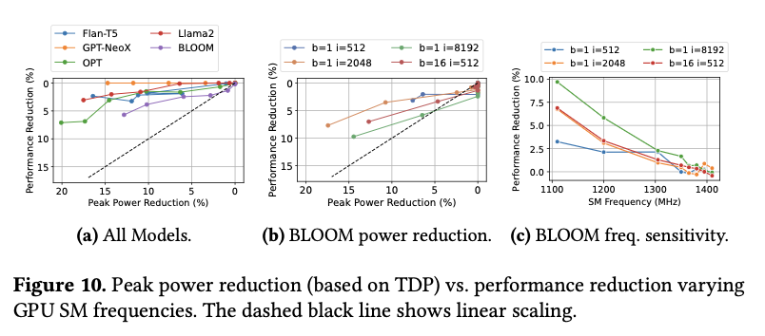
Design Implications
Improvements for Data centers
GPU server derating (reduce provisioned power)
Better OOB control interfaces
Coordinated CPU + GPU power management
Training vs Inference Strategy
Training:
  Avoid oversubscription
  Reduce power swings
Inference:
  Enable power oversubscription
  Use workload-aware strategies

Slide 14
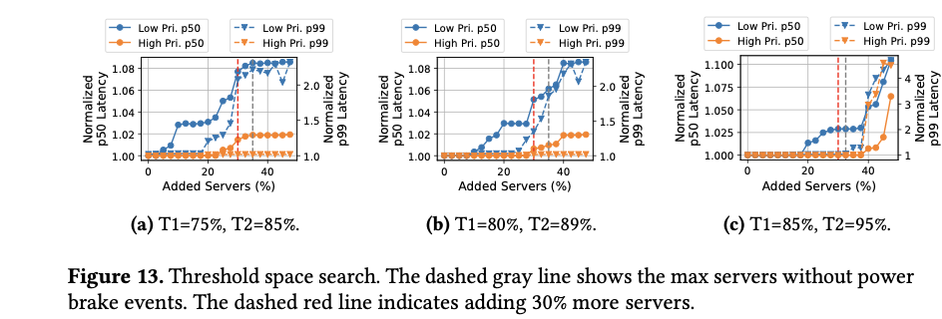

Slide 15
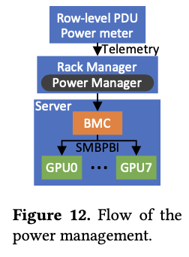
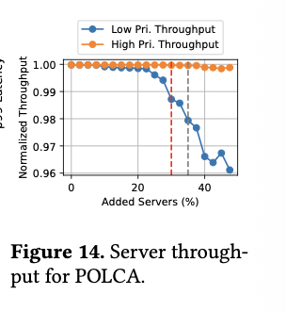
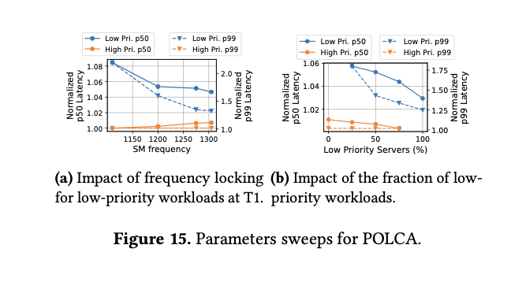
POLCA Framework
What is POLCA?
Power oversubscription framework
Designed for inference clusters
Key features:
  Priority-based control
  Safe power scaling
Result:
  +30% more servers deployed

Slide 16
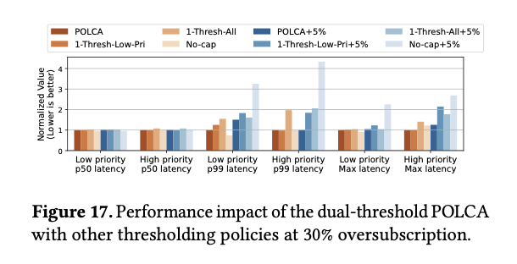

Slide 17
Conclusion
LLMs are power-hungry workloads
Training → rigid, high power
Inference → flexible, optimizable
POLCA shows:
Better utilization
Lower cost
Scalable solution

